Slide 1
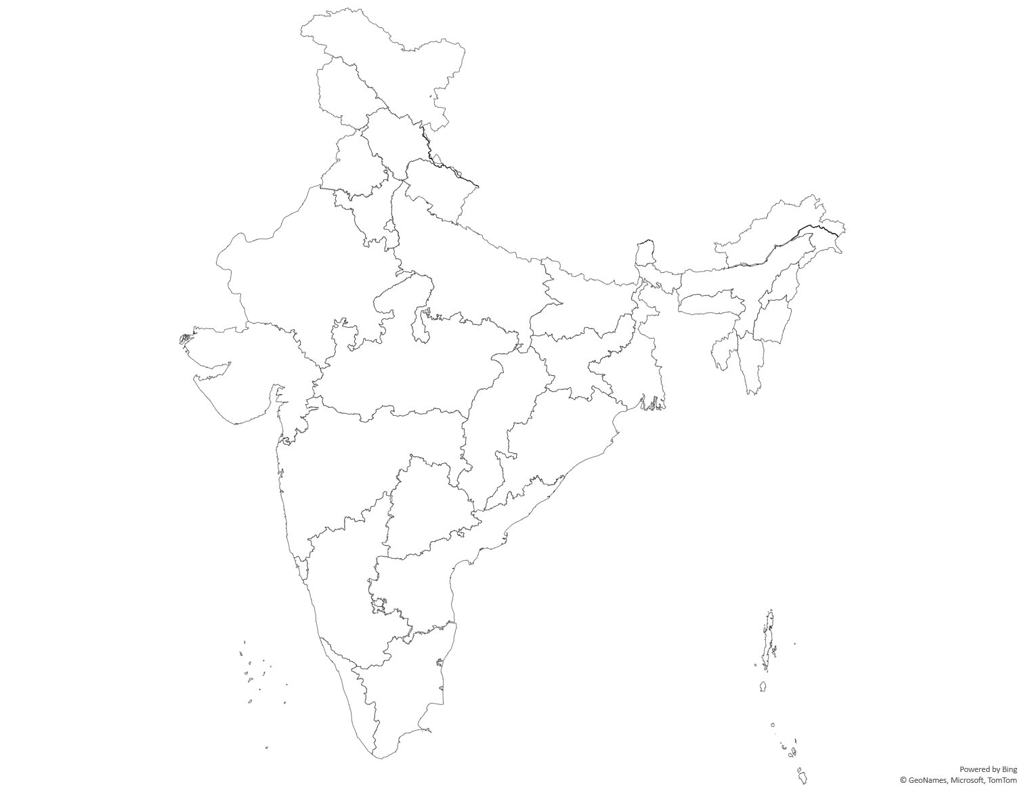
Menus
2024
Bangalore, Mumbai and Gurgaon

Slide 2
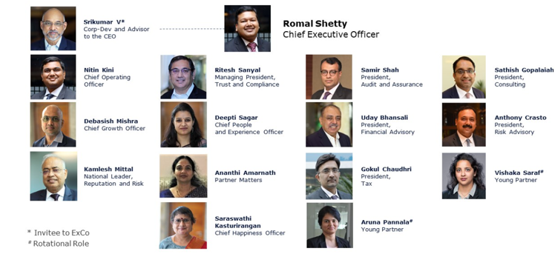



Executive Committee
Total Members – 16
Meal Preference – Veg / Non Veg
Any Specific Dietary Requirements
Any Known Allergies ( Seafood, Nuts, Milk & Milk Products )

Slide 3
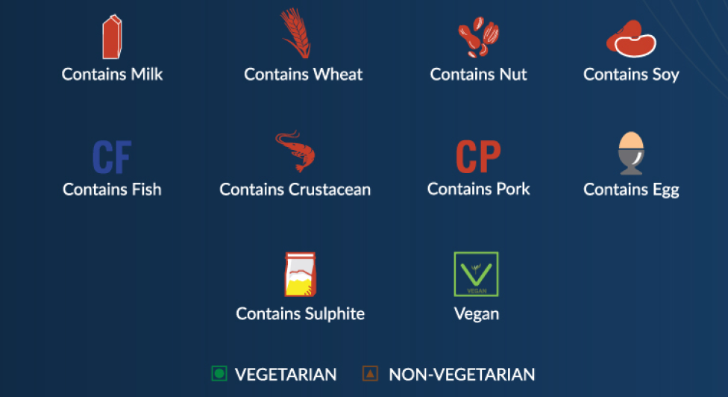
Demystifying Dietary Specifications & Meal Preferences
An average active adult requires, 2000 KCAL energy per day, though this may vary

Slide 4
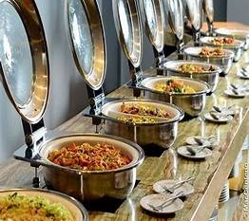
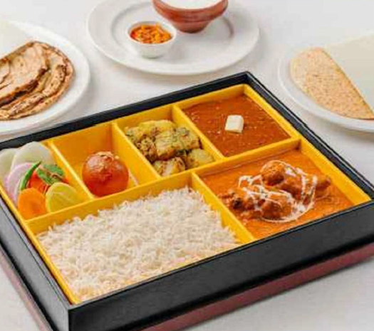
Possible options to cater differing needs

Slide 5
Menu Composition
Food | Menu Option 1 | Menu Option 2 | Menu Option 3
Mocktails / Welcome Drink / Chaas / Lassi | 1 | 1 | 2
Amuse Bouche | 0 | 1 | 1
Appetizer | 1 Veg | 1 Veg and 1 Non Veg | 2 Veg and 2 Non Veg
Papad, Raita, Pickle, Condiments and Chutneys | All | All | All
Curd Rice | 1 | 1 | 1
Main Course | 1 Veg and 1 Non Veg | 2 Veg and 2 Non Veg | 3 Veg and 2 Non Veg
Rice | 0 | 1 | 1
Flavoured Rice (like Pulao / Biryani / Fried Rice) | 1 | 1 | 1
Lentil | 1 | 1 | 1
Desserts | 1 | 2 | 3
Mukhvaas / Mouth Freshner | 1 | 2 | 3
All the Menus are exclusive of Transportation charges and taxes
Menu composition and price may change depending on final order
Wine Pairing options are available however Deloitte Team will have to procure Alcohol directly

Slide 6
Bangalore
Food | Menu Option 1 | Menu Option 2 | Menu Option 3 | Remarks
Mocktails / Welcome Drink / Chaas / Lassi | 1 | 1 | 2
Amuse Bouche | 0 | 1 | 1
Appetizer | 1 Veg | 1 Veg and 1 Non Veg | 2 Veg and 2 Non Veg
Papad, Raita, Pickle, Condiments and Chutneys | All | All | All
Curd Rice | 1 | 1 | 1
Main Course | 1 Veg and 1 Non Veg | 2 Veg and 2 Non Veg | 3 Veg and 2 Non Veg
Rice | 0 | 1 | 1
Flavored Rice (like Pulao / Biryani / Fried Rice) | 1 | 1 | 1
Lentil | 1 | 1 | 1
Desserts | 1 | 2 | 3
Mukhvaas | 1 | 2 | 3
ITC (Gardenia) | 2500 | 2750 | 3000 | 4.2 Kms to PTT, 15 Kms to Ecospace
Taj (West End) | 2500 | 3800 | 4000 | 1 Km to PTT, 20 Kms to Ecospace
Marriott (Ritz Carlton) | 3000 | 3200 | 4000 | 3.6 Kms to PTT, 15 Kms to Ecospace

Slide 7
Mumbai
Food | Menu Option 1 | Menu Option 2 | Menu Option 3 | Remarks
Mocktails / Welcome Drink / Chaas / Lassi | 1 | 1 | 2
Amuse Bouche | 0 | 1 | 1
Appetizer | 1 Veg | 1 Veg and 1 Non Veg | 2 Veg and 2 Non Veg
Papad, Raita, Pickle, Condiments and Chutneys | All | All | All
Curd Rice | 1 | 1 | 1
Main Course | 1 Veg and 1 Non Veg | 2 Veg and 2 Non Veg | 3 Veg and 2 Non Veg
Rice | 0 | 1 | 1
Flavored Rice (like Pulao / Biryani / Fried Rice) | 1 | 1 | 1
Lentil | 1 | 1 | 1
Desserts | 1 | 2 | 3
Mukhvaas | 1 | 2 | 3
Taj (President) | 2000 | 2500 | 3000 | 12 Kms to OIC, 11 Kms to DKC
ITC (Central) | 2000 | 2500 | 3000 | 2.2 Kms to OIC

Slide 8
Gurgaon
Food | Menu Option 1 | Menu Option 2 | Menu Option 3 | Remarks
Mocktails / Welcome Drink / Chaas / Lassi | 1 | 1 | 2
Amuse Bouche | 0 | 1 | 1
Appetizer | 1 Veg | 1 Veg and 1 Non Veg | 2 Veg and 2 Non Veg
Papad, Raita, Pickle, Condiments and Chutneys | All | All | All
Curd Rice | 1 | 1 | 1
Main Course | 1 Veg and 1 Non Veg | 2 Veg and 2 Non Veg | 3 Veg and 2 Non Veg
Rice | 0 | 1 | 1
Flavored Rice (like Pulao / Biryani / Fried Rice) | 1 | 1 | 1
Lentil | 1 | 1 | 1
Desserts | 1 | 2 | 3
Mukhvaas | 1 | 2 | 3
ITC (Maurya) | 2000 | 3000 | 3800 | 17 Kms to DLF, 27 Kms to AIPL
Marriott (Westin) | 3200 | 3500 | 4500 | 6.2 Kms to DLF, 10 Kms to AIPL
Taj (City Centre) | 3500 | 4000 | 4500 | 8 Kms to DLF, 11 Kms to AIPL

Slide 9
Bento Boxes for Bangalore
Hotels | Vegetarian | Non Vegetarian | Menu Option
ITC (Gardenia)* | 2750 | 3250 | Option 2
Marriott (Ritz Carlton) | 2000 | 2200 | Option 1
Taj (Qmin) | 1300 | 1400 | Option 1
Transportation, Taxes are charge extra
*ITC’s portion is size is for two guests

Slide 10
Bento Boxes for Mumbai
Hotels | Vegetarian | Non Vegetarian | Menu Option
ITC (Central)* | 2750 | 3250 | Option 2
Marriott (St. Regis) | 2250 | 2550 | Option 1
Taj (Qmin) | 1500 | 1600 | Option 1
Transportation, Taxes are charge extra
*ITC’s portion is size is for two guests

Slide 11
Bento Boxes for Gurgaon
Hotels | Vegetarian | Non Vegetarian | Menu Option
ITC (Maurya)* | 2750 | 3250 | Option 2
Leela (Ambience Mall) | 1800 | 2000 | Option 1
Taj (City Centre) | 2500 | 3000 | Option 1
Marriott (Westin) | 1300 | 1500 | Option 1
Transportation, Taxes are charge extra
*ITC’s portion is size is for two guests

Slide 12
Thank you

